Slide 1
What would happen when Underground Network under attack?
--- Robustness Exploration of London Underground Network
Wendi Li, Xiaoxuan Qin
December 05, 2024

Slide 2
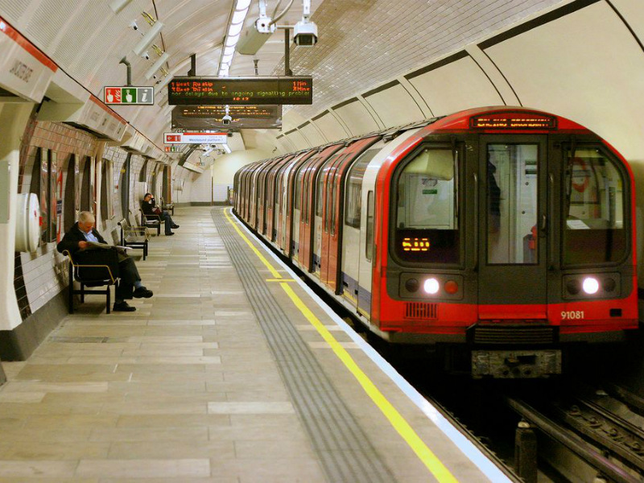
Background
The London Underground, or "the Tube," is the world’s oldest metro system, opening in 1863. Spanning over 400 kilometers, it plays a vital role in London’s daily life, making its resilience a key focus for researchers. One notable event was the King’s Cross fire in 1987, which caused 31 deaths and significant disruption. This tragedy led to major safety reforms and highlighted the importance of studying the network’s ability to withstand and recover from disruptions.
Notes:
Being the oldest underground railway in the world (established in 1863), the London Underground has evolved into a complex network with 11 lines and 272 stations. Its mix of old and modern design elements presents unique challenges for maintenance, robustness, and efficiency.
The Tube’s network exhibits a blend of central nodes (e.g., major hubs like King's Cross) and peripheral connections, making it an excellent subject for studying small-world properties, network centrality, and vulnerability.

Slide 3
Problem
How robust is the London Underground network?
Macro
Q1: Is the London underground network vulnerable?
Micro
Q2: What are the exact impacts when a station is out of service?
Notes:
Analyse if there are small-world properties
Analyse its performance when subjected to random attacks (randomised node attack) and targeted attacks (use centrality to figure out the top 20 nodes to attack in order）

Slide 4
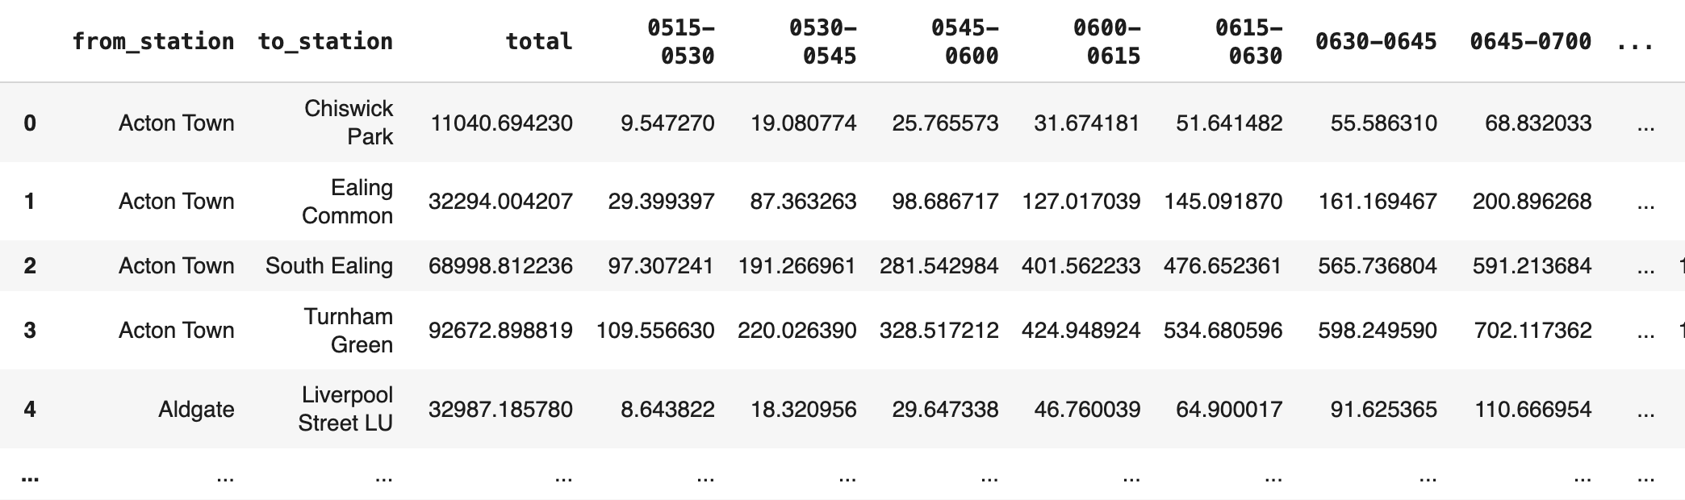
Data and Network Construction
(From Tfl government website: https://crowding.data.tfl.gov.uk/)
Link load (passenger flow) Dataset
Typical Weekday & Weekend day in fall 2022
Every 15min
1. Topological Network
Three Networks
2. Weekday Weighted Network
3. Weekend Weighted Network

Slide 5
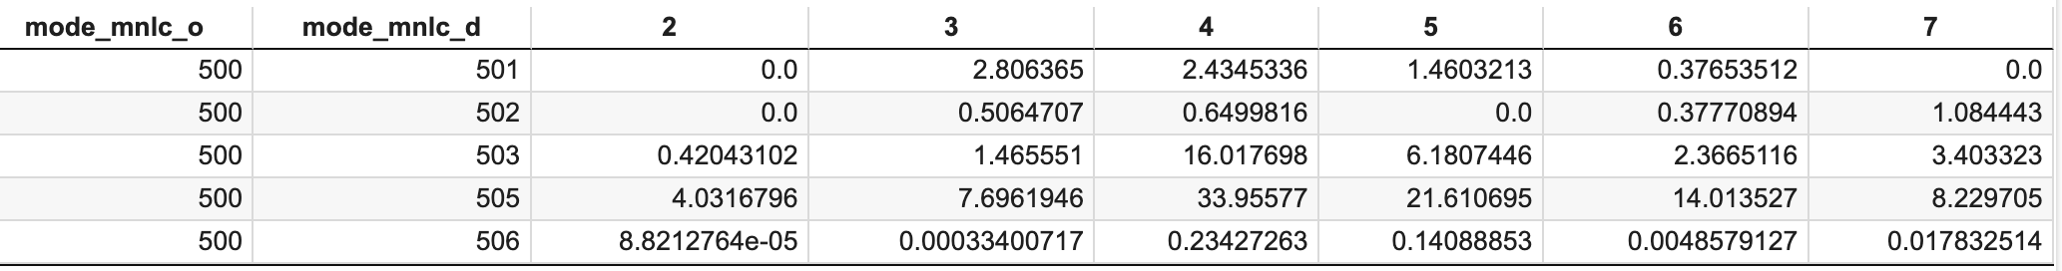
Origin-Destination Demand Data
Weekend
Weekday

Slide 6
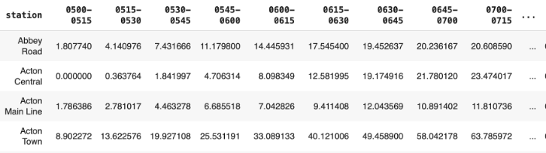
Entry Data

Slide 7
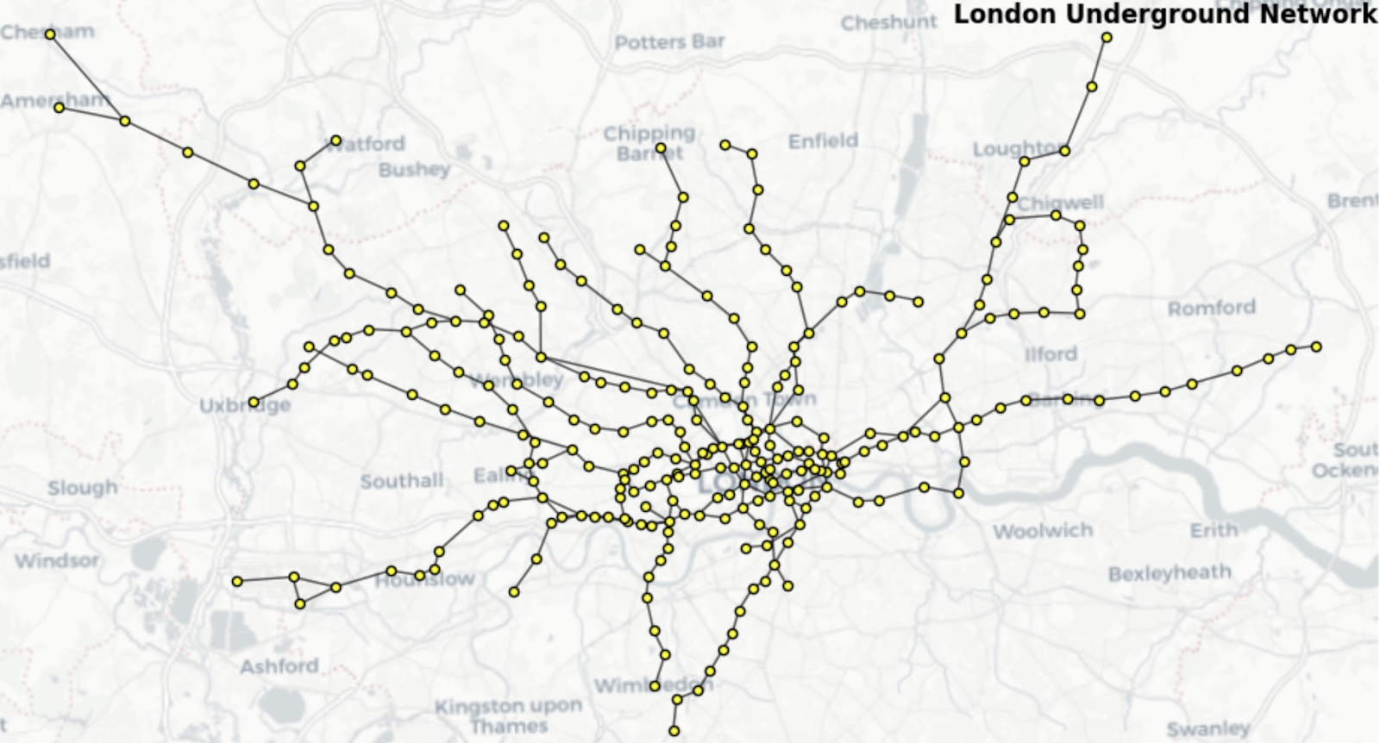
Network Visualization
11 Lines
zones 1 to 6
270 stations
Notes:
Most of the subway stations are concentrated in zones 1 to 6.

Slide 8
Part 1: Topology and Robustness Analysis

Slide 9
Small – World Property
Network | Actual Clustering Coefficient | Random Clustering Coefficient(Avg) | Actual Shortest Path Length | Random Shortest Path Length(Avg) | Results(Is or Not Small-World Properties)
Topological Network | 0.031040 | 0.005448 | 13.954151177199504 | 6.282330440119177 | NOT Small-World
Weighted Weekdays Network | 0.006092 | 0.000775 | 0.000375 | 0.000167 | NOT Small-World
Weighted Weekend Network | 0.005998 | 0.000820 | 0.000322 | 0.000161 | NOT Small-World
Notes:
The first assessment we did is to check if this network has a small – world property, Networks with small-world features (marked by high clustering coefficients and short average path lengths) are often more robust to random failures and have more alternative links.
Here, we test both topological network and weighted networks. here we use a commonly used approach, that is compare the actual networks with ER random network. For topological network, we build the ER random network with the same number of nodes as the real network. For the weighted network, In addition to building the topology according to the same number of nodes as the real network, we also randomly redistribute the weights the real network to the random network. And To ensure the reliability of the results, all random graph were calculated as the average over 50 iterations. However, the results show that No network satisfies the small-world condition.

Slide 10
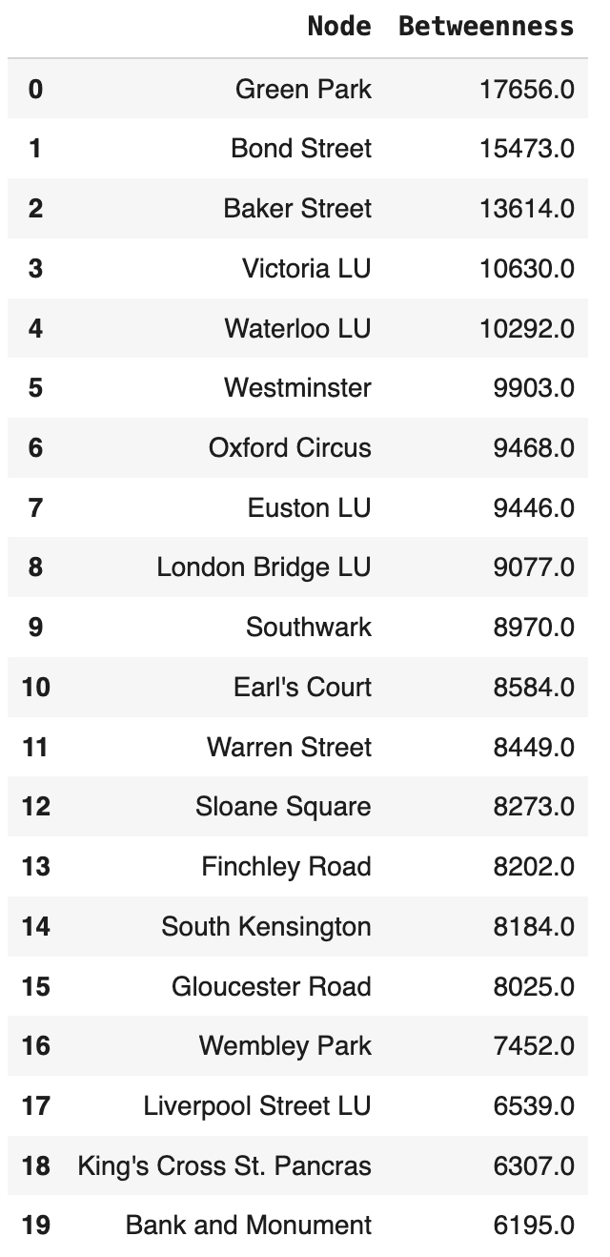
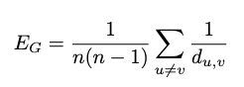
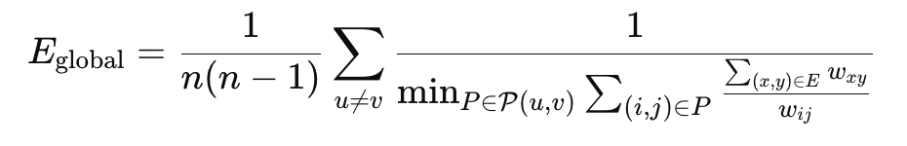
Random & Targeted Attack
e.g. Top 20 Betweenness Centrality Stations from Weekend Weighted Network
Step 1: Calculate Top 20 Betweenness Centrality Nodes for three networks (topological network, weekend weighted network, weekday weighted network)
Step 2: Attack nodes in sequence
Step 3: After each attack, recalculate network efficiency
(For random attack, randomly select 20 nodes and perform the same action）
Global efficiency for topological network:
Global efficiency for weighted network:
Computing the efficiency for all node pairs by evaluating the inverse of their shortest path distances, adjusted by normalized weights, and then averaging these values across all possible pairs in the graph.
Notes:
Then we did another assessment of random and targeted attack. We calculated the top 20 nodes with the highest betweenness centraliy. And then remove them one by one in sequence. After each removal, we recalculate the network efficiency. We also performed the same action for 20 randomly selected nodes.

Slide 11
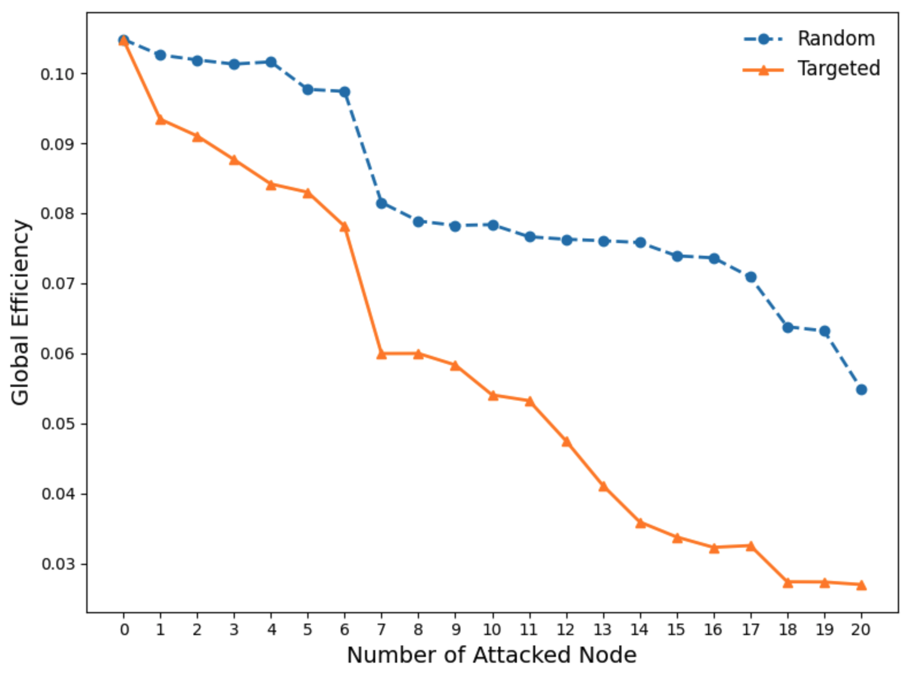
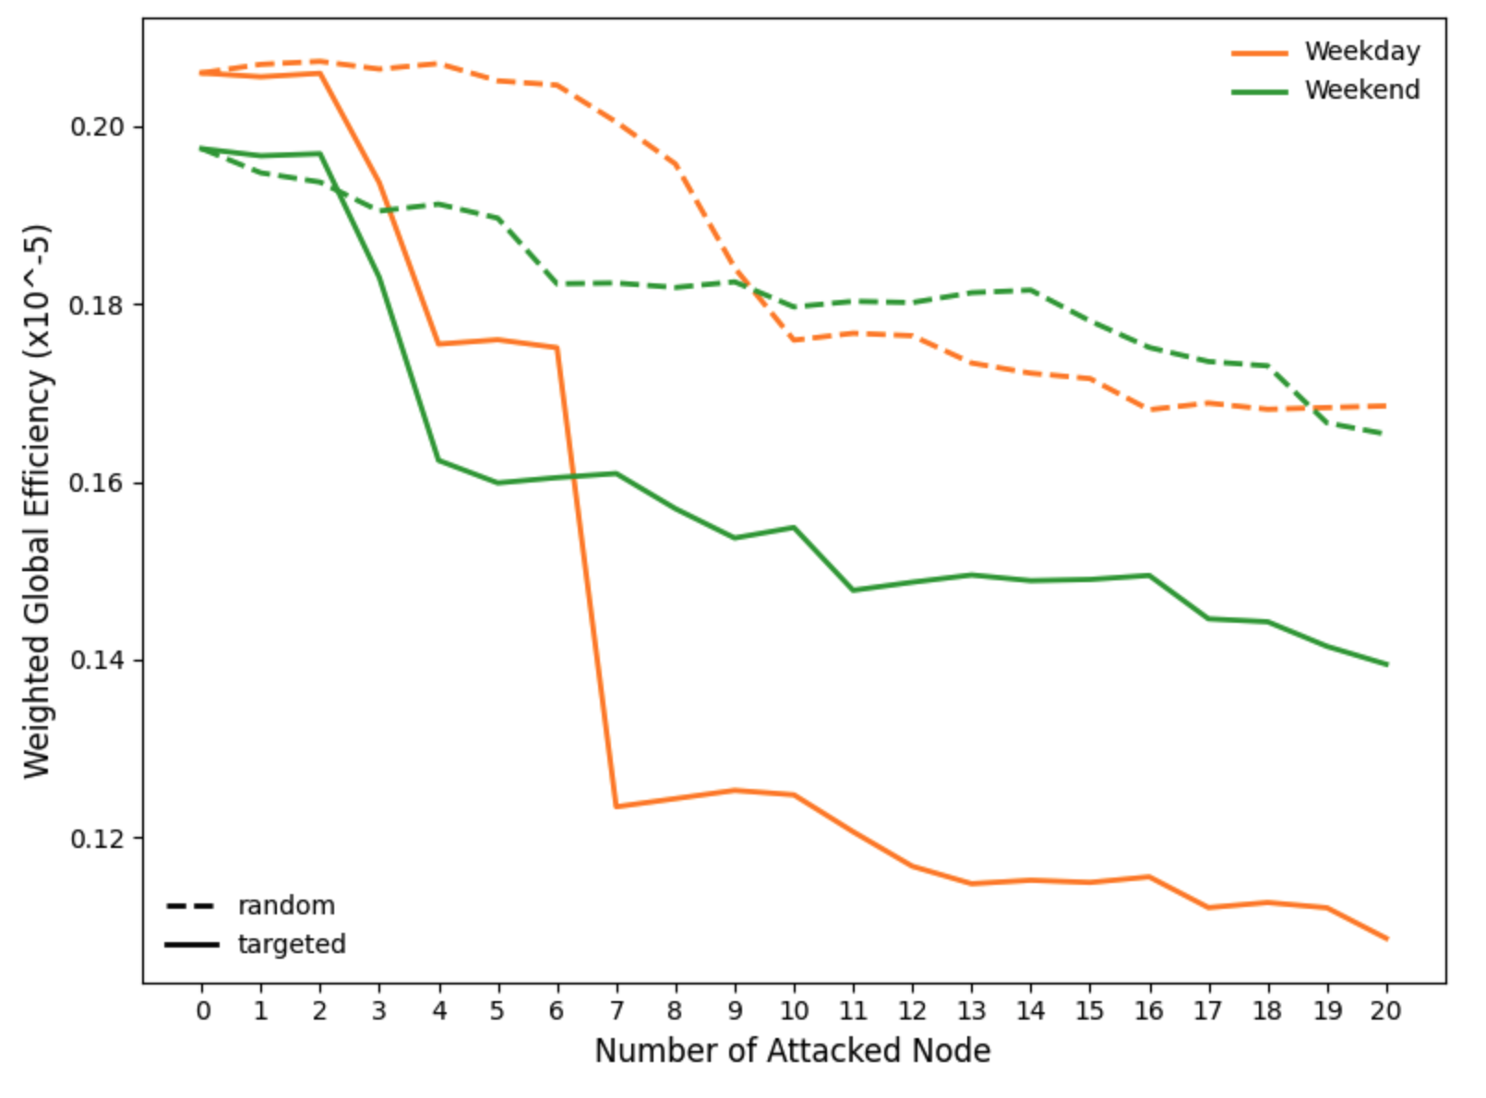
Random & Targeted Attack
Topological Network
Weighted Network
All three networks are vulnerable for both random and targeted attacks, especially for targeted attack
Weekdays will be more affected than weekends
Notes:
Then we got the results. When certain nodes are being attacked, All three networks show a clear decline in efficiency, which suggest that all three networks are not resilient or robust when being attacked.
Compared to random attack, targeted attack causes more damage to the network across all three cases. The downward curve of random is relatively moderate.
If we look at the weighted network, (We found that on weekdays with high travel demand. targeted attacks make the network more inefficient. This means that cause more severe impacts.) In weekday Attacks can make networks have a bigger impact compare to over the weekend
In conclusion, combining these two assessments. We find that London underground network may be relatively vulnerable. But we don’t know what does vulnerability perform exactly?

Slide 12
Part 2: Attack Scenario Simulation
Notes:
/ˈmaɪkrə

Slide 13
When a specific station is disrupted:
1. [Network Operation Efficiency] What do the impacts vary different disruption durations and different disruption start times?
2. [Passenger Travel Demand] What percentage of people in London will be affected, and what percentage will be unable to meet their travel demand?
Notes:
We assume that when a specific station is disrupted. There are two aspects will be impacted. The first one is the underground operation efficiency, that means Route is more congested and travel time is longer than it should be。The second aspect is the travel demand, that is, whether someone’s demand can still be satisfies. Because of the closure of some of the stations, people who were going there can‘t get there. For the

Slide 14
When a specific station is disrupted:
1. [Network Operation Efficiency] What do the impacts vary different disruption durations and different disruption start times?
2. [Passenger Travel Demand] What percentage of people in London will be affected, and what percentage will be unable to meet their travel demand?

Slide 15
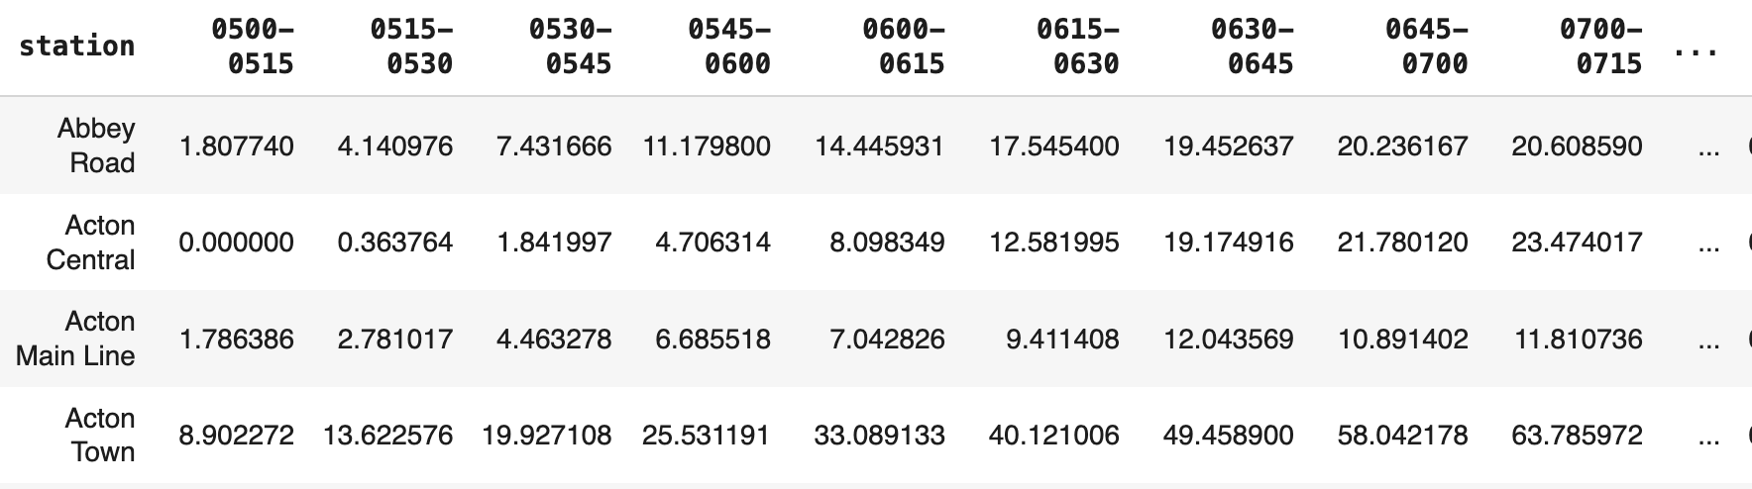
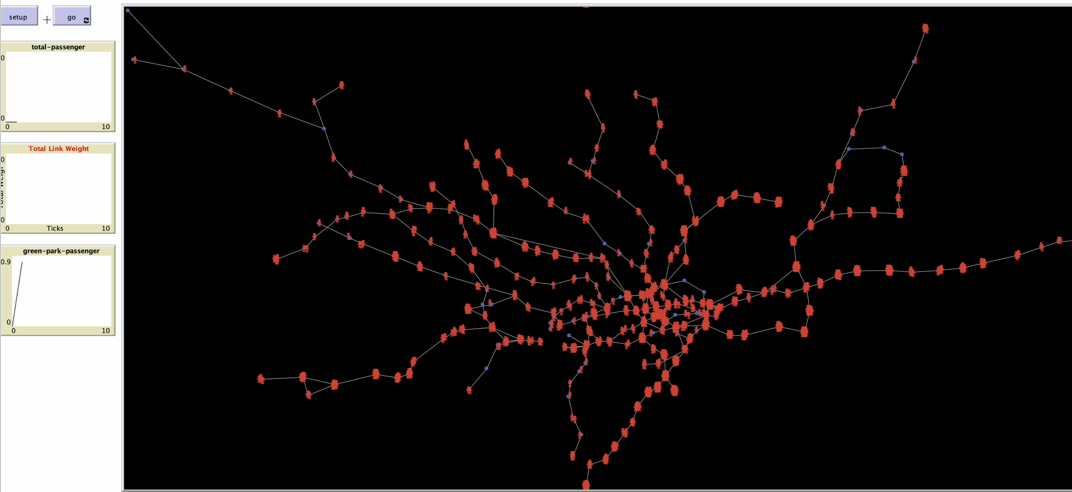
Agent-Based Modelling (ABM)
Entry data (15min unit)
Agents and Action Rule Examples
Agents | Action Rules (example)
Stations Passengers | Each passenger's target station is a neighbor of the current station and does not walk on the link that the last tick travels through When a passenger encounters an out-of-service station, the travel time is increased by 20 minute……
Initial setup
station
monitor space
passenger
15
Notes:
For the first exploration, we use ABM to do a dynamics simulation
Agent-Based Modeling (ABM) is a method that based on agents and individuals. In the modelling system, we can define multiple subjects and their corresponding attributes. And we can also set specific rules for how they act. To make it simple, we can create a virtual world.
For example, in our case, the system has two types of agents: stations (the blue point in the figure, it is the static /ˈstætɪk/ agents) and passengers (red shape, it is the shape of a very small person - are dynamic agents).
There are a lot of action rules in this system, e.g. certain number of passengers will be generated at specific stations in specific time based on the entry data (How many people enter this station in 15 minutes?). And the passengers can move only along links, and having passengers exit the system once they reach their destinations after a certain period.
Once we’ve defined all the agent attributes and rules, we can hit “go,” and the system starts running based on these rules. During the running time, we can monitor some variables we’re interested in, and we can also export them as files it for further analysis.

Slide 16
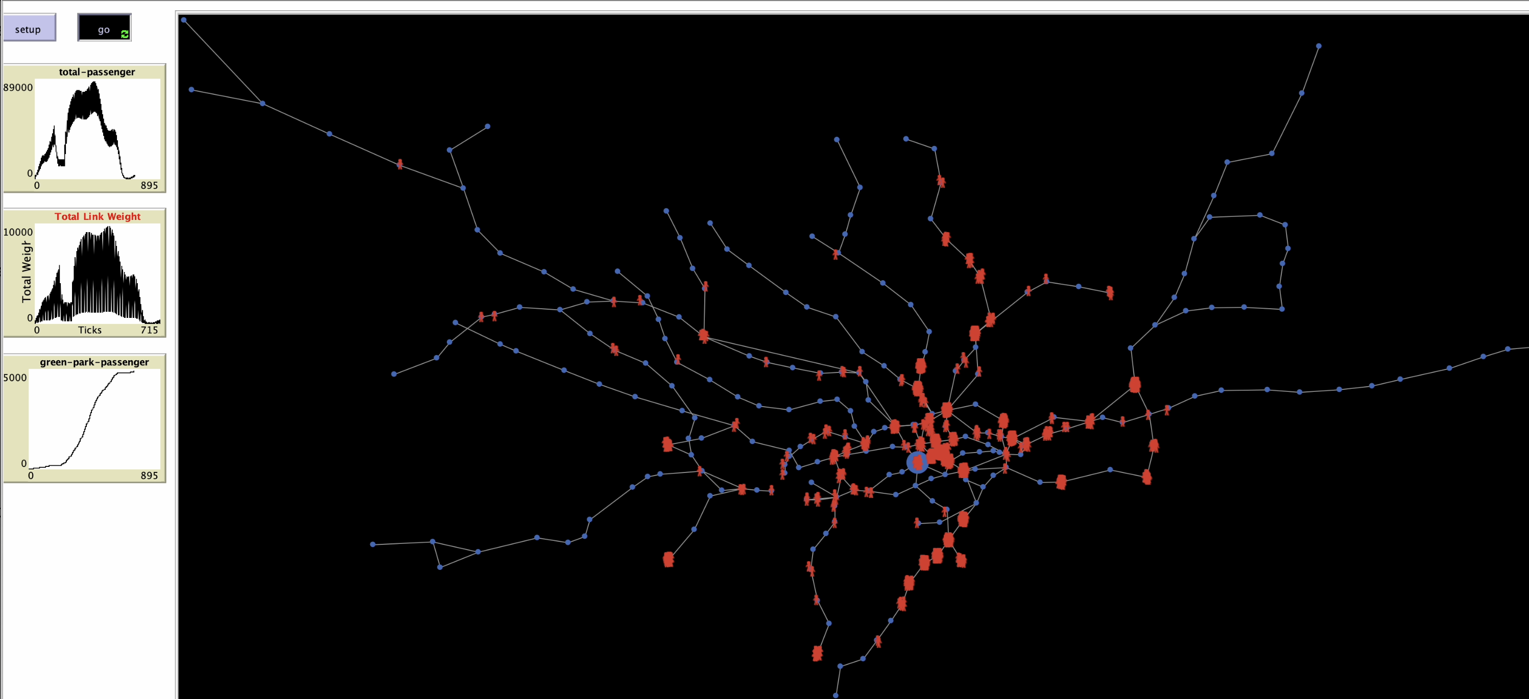
Agent-Based Modelling (ABM)
Nearly at the end of its run
“Green Park” station is closed
16
Notes:
Once we’ve defined all the agent attributes and rules, we can hit “go,” and the system starts running based on these rules. During the running time, we can monitor some variables we’re interested in, and we can also export them as files it for further analysis.
In a certain time point, we simulate that one of the stations is failed. So in this way, we can know the network changes when it encounter the disruption.

Slide 17
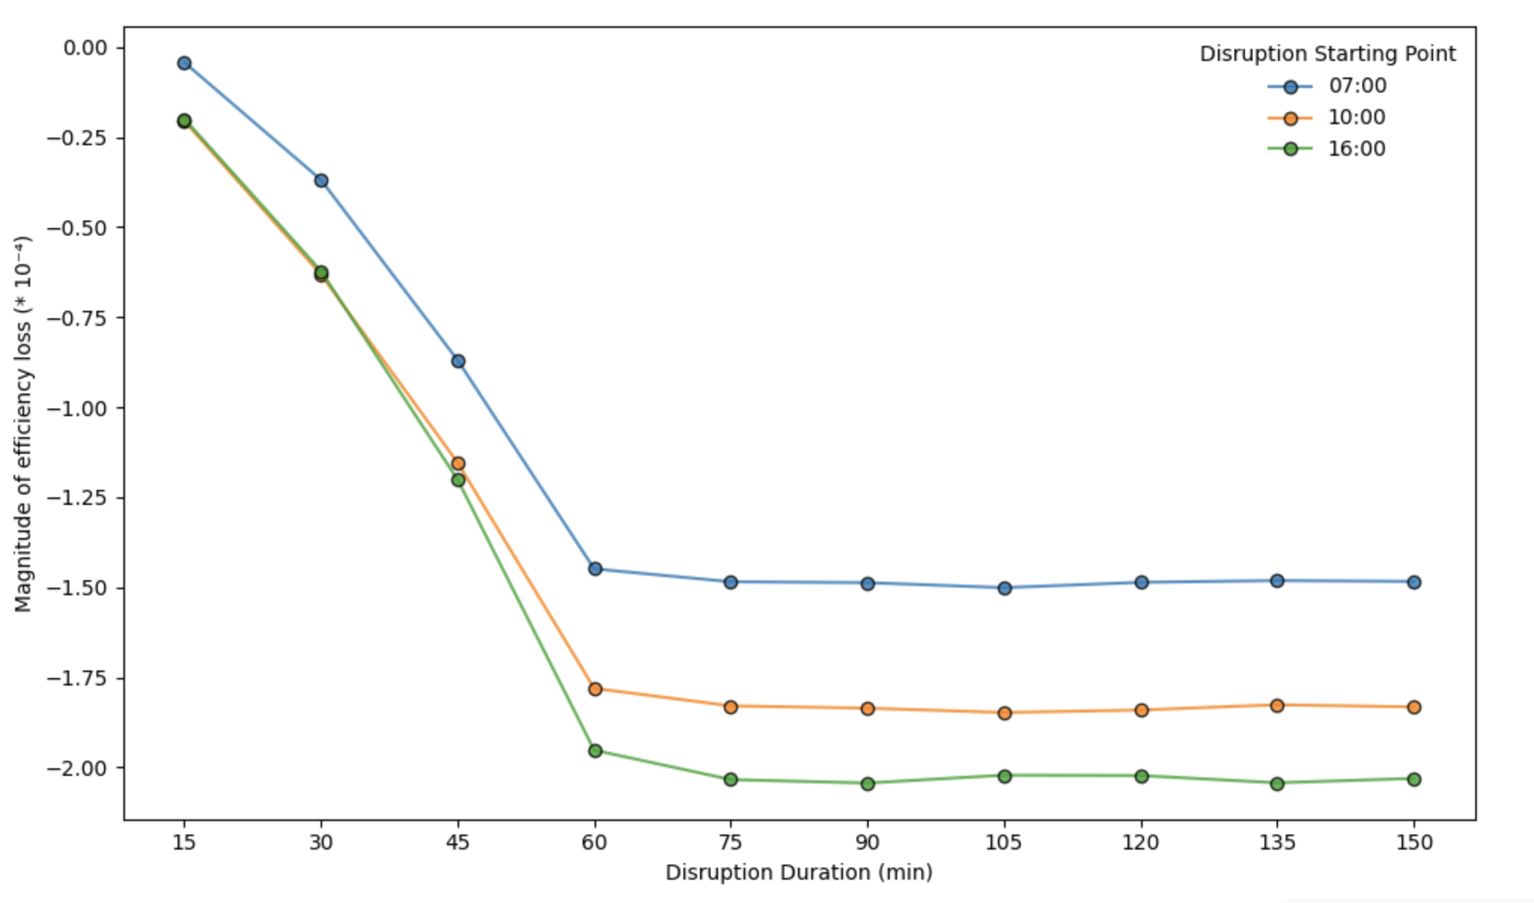
Simulation for one of the most central Stations
30 simulations: 10 durations * 3 starting-point
“Green Park” Station
Network efficiency decreases in all scenarios when the central station is closed.
Efficiency reduction increases sharply for durations up to 60 minutes but stabilizes afterward
Station closures during the evening rush hour (starting at 4 PM) have the greatest impact
17
17
Notes:
It‘s our attempt at an important point. The figure shows how network efficiency change when the closue or attack happened in different time period and lasted for different duration.
The horizontal coordinate is the DISRUPTION DURATION, and we modeled 10 pause durations between 15min and 150min (since we derived the average pause time of a site from a pause dataset to be roughly 150 minutes), the y axis is the network efficiency reduction. Different lines indicate different disruption starting time.
1.When this central station is closed, the network efficiency will reduce among all scenarios.
2.When the duration is between 15 and 60 minutes, the reduction in the efficiency increases significantly as the duration increases. However, the reduction magnitude become stable after 60 minutes. This tells us that a station that's off for 150 minutes may have similar impact on the entire network as one that's off for 60 minutes.
3,And from the three different lines we can know, Station closures have the greatest impact if they occur during the evening rush hour, which begin from 4pm in the afternoon
Here we are just making the most initial attempt

Slide 18
When a specific station is disrupted:
1. [Network Operation Efficiency] What do the impacts vary different disruption durations and different disruption start times?
2. [Passenger Travel Demand] What percentage of people in London will be affected, and what percentage will be unable to meet their travel demand?

Slide 19
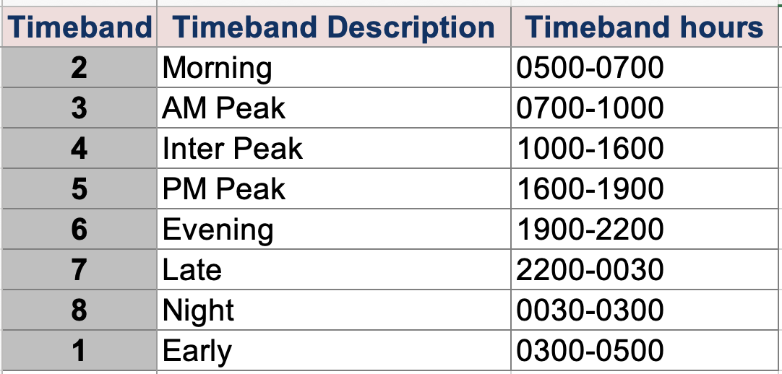
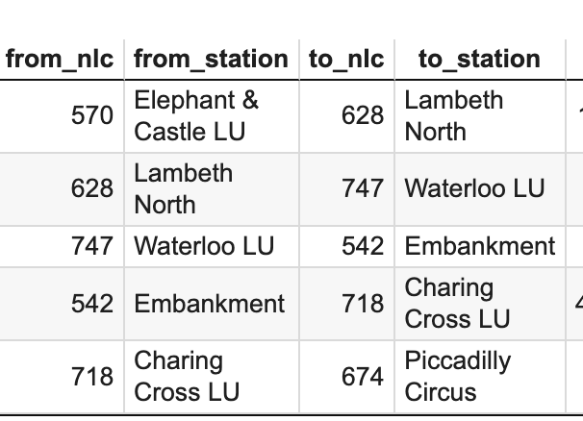
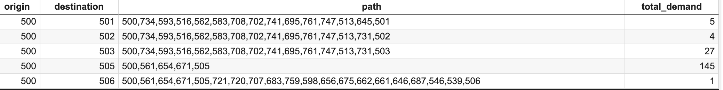
Origin-Destination Demand Data
Providing detailed information on passenger flows between origins and destinations(travel demand) across different time periods, allowing us to quantify network demand.
Integrate passengers’ travel demand data into network topology based on mode_mnlc/nlc

Slide 20
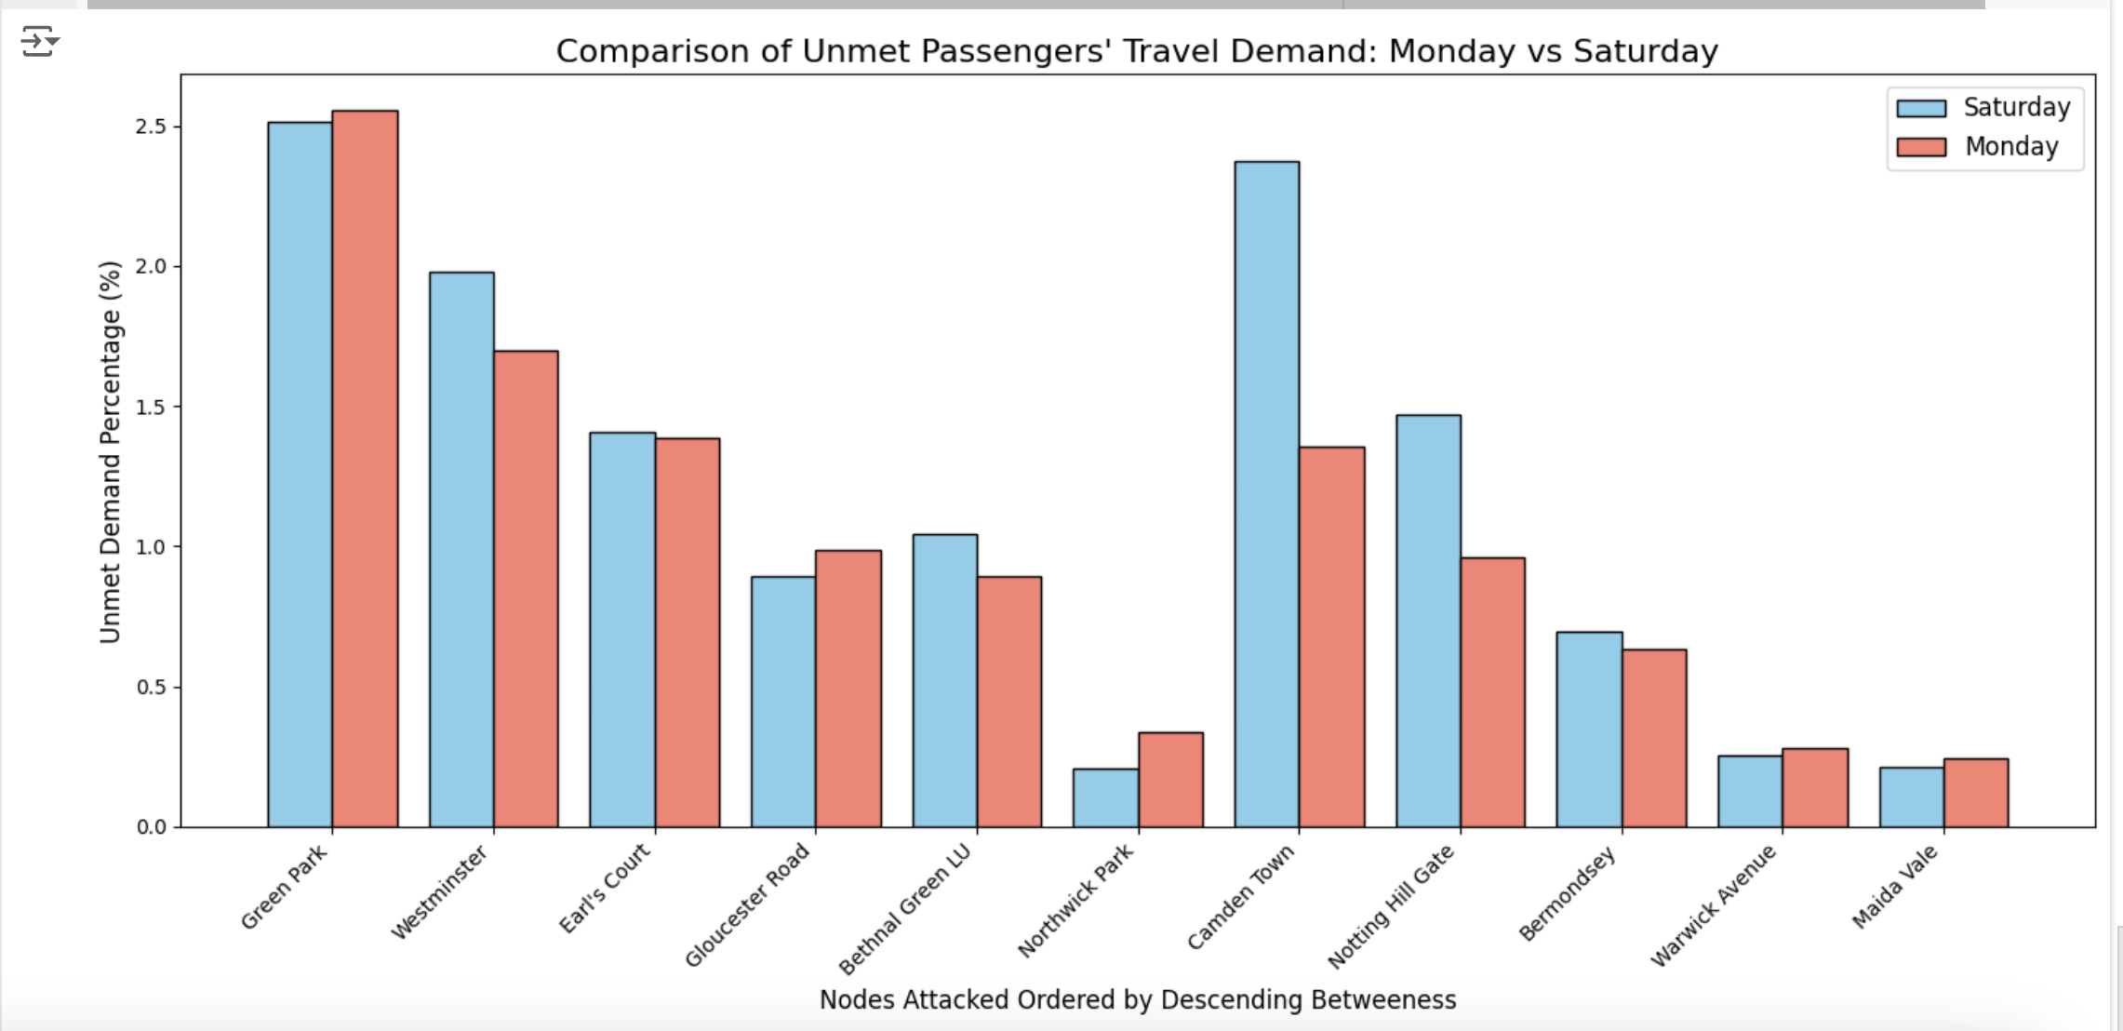
Percentage of Unmet passengers’ travel demands under targeted attack on Weekday and Weekend
If a targeted (attacked) node serves as either the origin or destination in a travel demand, it is assumed that the passenger's travel demand cannot be satisfied, as the starting or ending point of the journey is no longer accessible.
If a targeted node functions as an intermediate transfer point, and no alternative path exists to connect the origin and destination, the passenger's travel demand will also be considered unmet. This reflects the lack of feasible routes due to network disruption.
Only at most 2% passengers’ travel demands will not be able to meet!

Slide 21
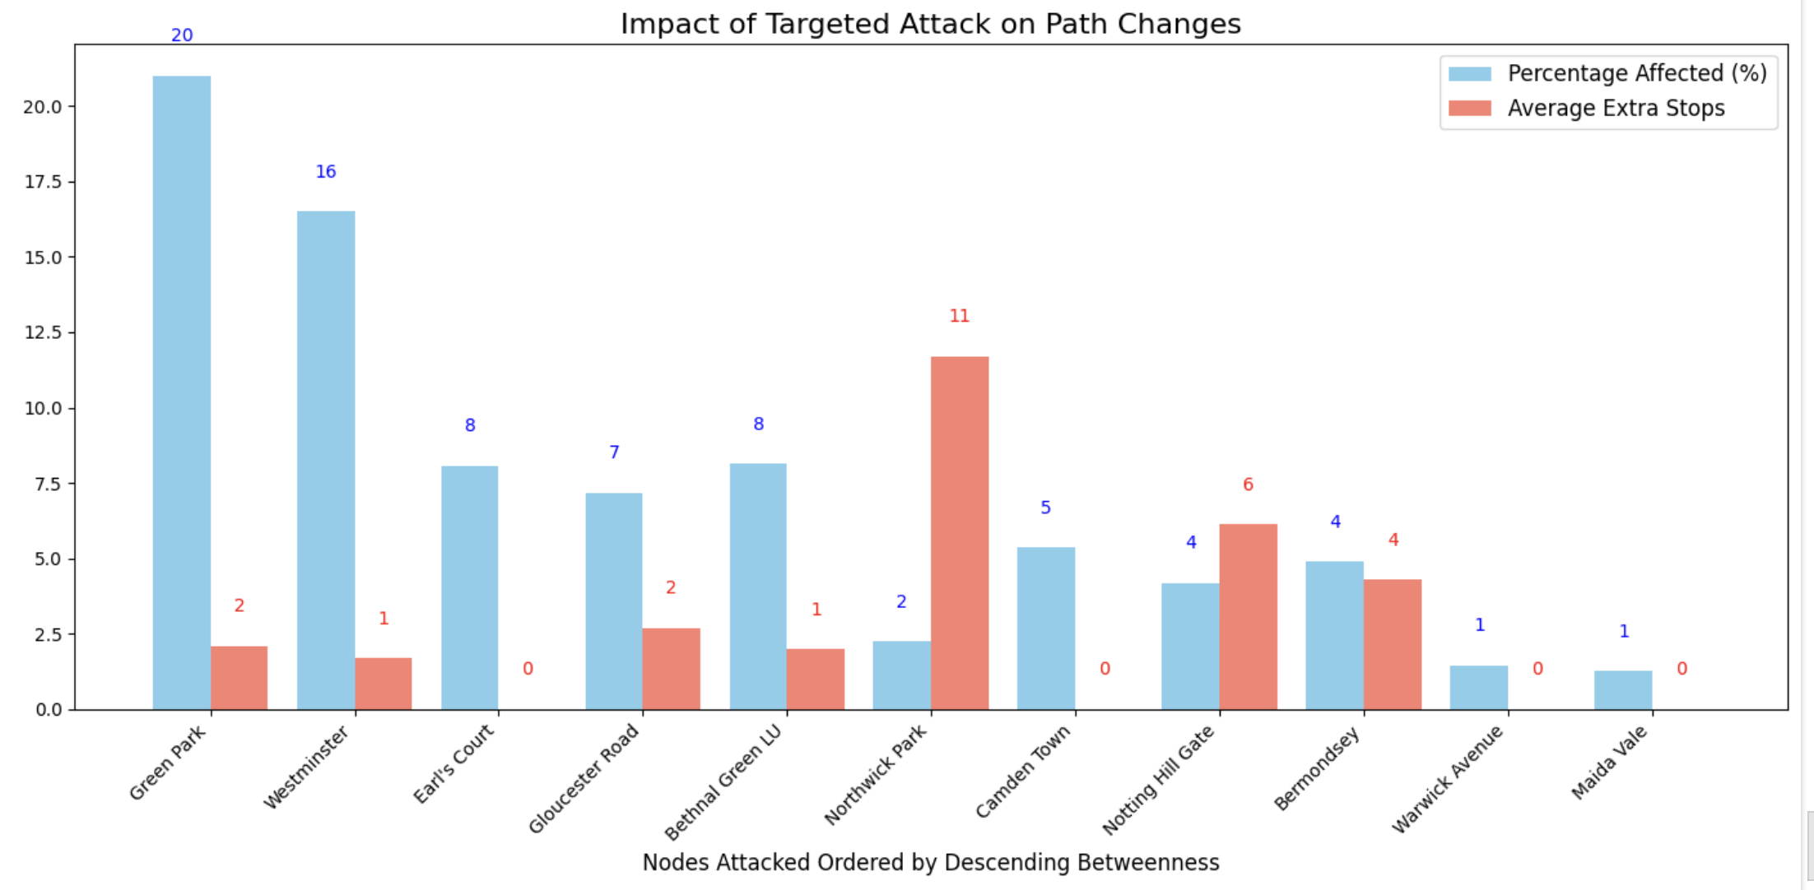
Path change effect under targeted attack
What proportion of the network‘s total demand must adjust to new routes under targeted attack?
What is the overall inconvenience caused by node disruption in terms of travel efficiency?

Slide 22
Thank you for your listening
Wendi Li, Xiaoxuan Qin
Dec 05, 2024
Notes:
I‘d like to share an article I read in nature communication. I think this article is relevant to our research and the methods used are interesting and novel.

